Slide 1

Difference in Differences
Professor Harry Krashinsky
EMBA 46: QRM 2025

Slide 2
Causality
The whole point of this course is to encourage you to make strategic decisions on the basis of good statistical evidence.
Here, “good” evidence is not plagued by OVB, and stems from causal results.

Slide 3
Some motivation for causality
But where does causal evidence come from?
We’ll soon see that it’s drawn from techniques that originated in medicine (but are highly relevant to business applications, too).
In medicine, decisions focus on understanding how treatments cause better outcomes for patients, and not treatments that are merely correlated with better outcomes

Slide 4
Some motivation for causality
But how do we distinguish between treatment strategies that are correlated with better outcomes, and those that cause better outcomes?
We’ll discuss exactly this issue, and I will argue that this idea is essential for determining proper business strategy (and other things) for everyone

Slide 5
Some motivation for causality
Key issue: You are all faced, broadly, with the same key question in your businesses: should you pursue a particular business strategy or not?
I will argue that you should understand the causal effects of a particular strategy, not just the outcomes correlated with using that strategy.

Slide 6
Correlation vs Causation
How do we distinguish between correlation and causation?
→You’ve seen how the inclusion of more variables into a regression can change the coefficients on other variables.
This is the principle of OVB

Slide 7
Correlation vs Causation
It also showed the great problem with interpreting a regression as “causal”
The key issue: regressions only show us correlations. But it’s only the regression results that aren’t prone to OVB that are considered to be “causal”

Slide 8
A call back to an earlier example
Remember those cakes we talked about? Here’s a reminder:
One-Layer Cake | Two-Layer Cake
$10, $10, $10, $10, $10, $10 $16, $16 Average Price = $11.5 | $10, $10 $16, $16, $16, $16, $16, $16 Average Price = $14.5

Slide 9
A call back to an earlier example
We ran a simple regression here, and it looked something like this:
(Cake Price) = 8.5 + 3(Number of Layers)
But this was naive, since it suffered from OVB

Slide 10
A call back to an earlier example
Instead, when we thought about a second factor (amount of frosting), the story changed:
Now, the impact of layers looked a lot different (it looks like it has NO impact on price).
 | One-Layer Cake | Two-Layer Cake
Two Cups of frosting | $16, $16 | $16, $16, $16, $16, $16, $16
One Cup of frosting | $10, $10, $10, $10, $10, $10 | $10, $10

Slide 11
A call back to an earlier example
Our regression looked something like this:
(Cake Price) = 4 + 0(Number of Layers)
+ 6(Cups of Frosting)
Why did the results change so much?

Slide 12
A call back to an earlier example
This was a classic case of OVB. When we omitted Frosting from the regression, it’s impact was picked up by Layers, because the two variables were positively correlated.
→Why is this the case? Here’s the logic

Slide 13
A call back to an earlier example
Customers really value frosting, but don’t care about layers.
Cakes with more layers also happened to have more frosting on them.
When we omitted Frosting, Excel told us that the price went up when Layers went up. But this was only due to (2): when layers increased, so did frosting (the important – and missing – factor)

Slide 14
A call back to an earlier example
Hence the problem of OVB!
It is very hard to draw causal conclusions in any study, unless we are carefully aware of notions of omitted variables bias. (We also call this “endogeneity” or “selection bias” or problems of “sample selection”, but it’s all the same problem)

Slide 15
Big Point
We’ve said that OVB is unavoidable
We’ll always leave something out because:
We know about it but can’t collect information on it, or
We may not be aware of something important

Slide 16
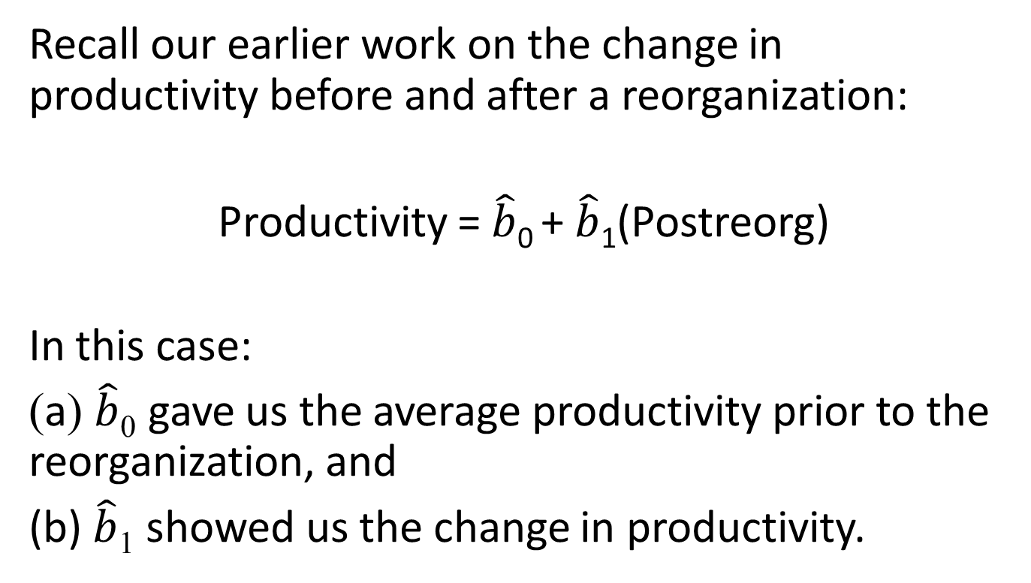
How does this relate to our current discussion?
Recall our earlier work on the change in productivity before and after a reorganization:
Productivity = $\hat{b}$₀ + $\hat{b}$₁(Postreorg)
In this case:
(a) $\hat{b}$₀ gave us the average productivity prior to the reorganization, and
(b) $\hat{b}$₁ showed us the change in productivity.

Slide 17
How does this relate to our current discussion?
But remember: if something is missing from our regression, we can draw the wrong conclusion from our work.
So what are the assumptions here that might be overlooking this omitted variable problem?

Slide 18


Recall our earlier case
What would have happened if we had always had the change
What would have happened if we had never enacted the change
$\hat{b}$₁
$\hat{b}$₀

Slide 19
Note the assumption here
We’re assuming that nothing would have been different about productivity had we never enacted the change
But is this a reasonable assumption?
→ Probably not. (Uh oh)

Slide 20
So how do we circumvent this problem?
Let’s take a step back and ask ourselves how we would determine the causal relationship between X and Y if we were omnipotent.
As an example, let’s suppose that I was interested in examining the impact of a new incentive system on the productivity of my workers.

Slide 21
If I had unlimited powers, I would take a single individual, employ him/her under the incentive program (like a commission-based contract) and then measure their productivity afterwards.
Then, I would put him/her in a time machine, deny them the new system, and measure their productivity in that case.
The causal effect of the system would be represented by the difference in productivity in this case.

Slide 22
Why would this work?
It would tell me the “counterfactual” story for the individual – what productivity they would have had in the absence of particular system.
But we can’t do this (or at least, not yet…)

Slide 23
The next best thing
In order to approximate this case, we borrow an approach from the medical literature.
In order to test the efficacy of an experimental drug, what do medical researchers do?

Slide 24
The next best thing
Randomized trials! They take two groups who are otherwise equivalent (this is very important), and randomly assign the drug to one group (known as the “treatment” group) and give a placebo to the other (known as the “control” group). The outcomes for the two groups are then compared.

Slide 25
The next best thing
Why does this work?
We can make a plausible argument that the control group provides a close approximation for what would have happened to the treatment group in the absence of the receiving the drug – the “counterfactual” outcome.

Slide 26
An early example
In the mid-nineteenth century, London suffered a series of cholera epidemics, and their cause was unknown.
The prevailing theory was that the virus was transmitted by “bad air”, but Dr. John Snow believed that cholera was transmitted by bad drinking water.

Slide 27
Snow’s study
Two water companies (Southwark and Vauxhall company (SV) and Lambeth) both drew water from the polluted Thames in 1849.
In 1852, Lambeth moved its operation to a relatively sewage-free area, but SV stayed at the Thames.
Snow compared changes in cholera-related death rates for customers supplied by both companies.

Slide 28
Snow’s study
Snow found that death rates declined precipitously in districts supplied by Lambeth compared to the changes in death rates for districts supplied by SV.
A causal effect of clean water on cholera deaths!

Slide 29
Snow’s study
Why were we convinced by Snow’s study?
Initially, the same water is supplied by both companies
One company changes water supply (treatment) while the other remains at the Thames (control)
The differences in “differences” are compared

Slide 30
Snow’s study
But is there some issue that might undermine the study?
Random assignment?
Comparability of treatment and control consumers?

Slide 31
Differences in Differences
The key consideration is trying to ensure that the treatment and control groups are otherwise similar prior to the intervention (otherwise, arguing that you’ve got a “causal” effect is going to be difficult)
To ground this discussion, suppose I want to think about the impact of a reorganization on productivity for our workers, so I provide training to one subset (the “treatment” group) but not another (the “control” group)

Slide 32
Differences in Differences
In fact, what we’d love to see is something like this:
 | Pre-reorganization average productivity | Post-reorganization average productivity | Difference
Treatment Group
Control Group
 | Difference-in-Differences
$12
$20
+$8
$11
$13
+$2
$8 – ($2) = +$6

Slide 33
Differences in Differences
Why is this great?
(1) The two groups are otherwise similar (in wage terms) prior to the intervention
(2) We can actually see that the treatment group improved at a far more rapid rate than the control group – shown by the D-i-D!

Slide 34
Graphically
Productivity (in $)
Treatment’s change
Control’s change
Time of Reorganization

Slide 35
Graphically
Difference in differences
Treatment’s change
Control’s change

Slide 36
So why are regressions relevant here?
Two reasons:
We’d like to see if the difference-in-difference is statistically significant.
We might also like to control for some other variables, too.

Slide 37
So how do we use regression here?
Well, it’s a little tricky, but it will make sense eventually.
So hang in there with me.
Here we go!

Slide 38
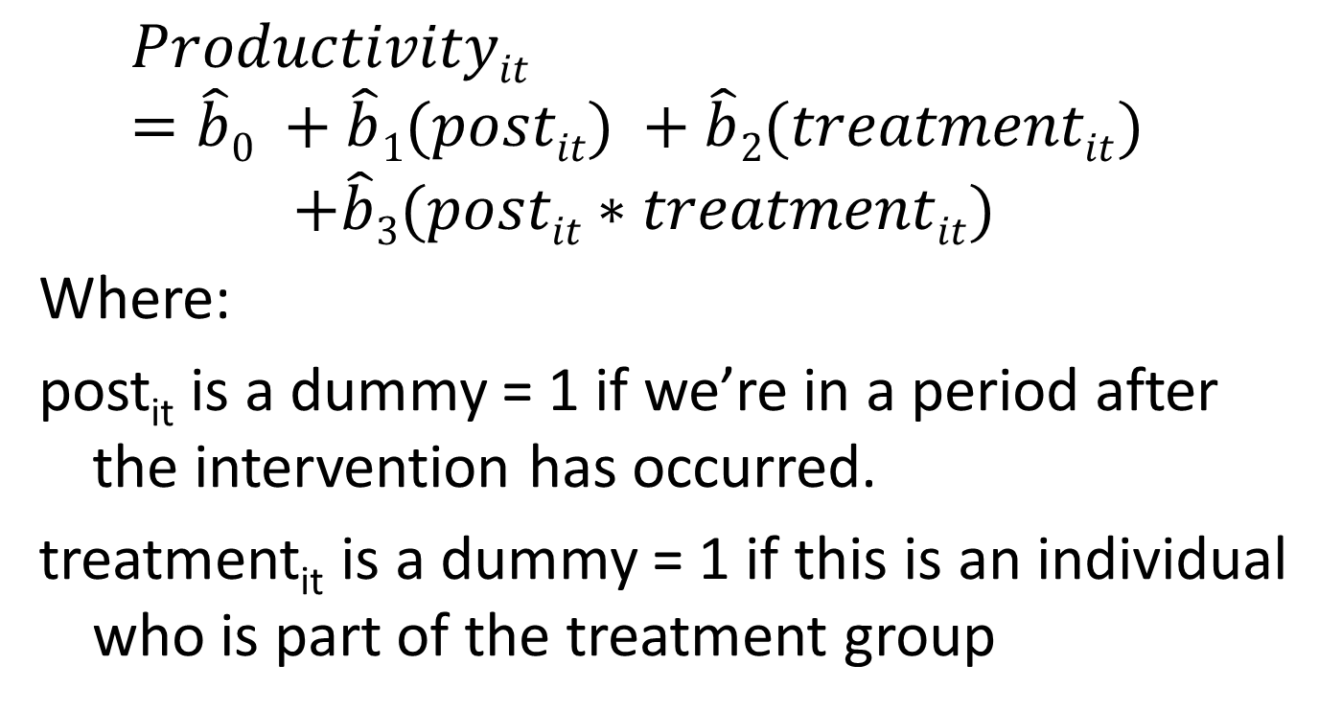
So how do we use regression here?
$$Productivityit =\hat{b}0 +\hat{b}1(postit) +\hat{b}2(treatmentit)$$
$$+\hat{b}3(postit∗treatmentit)$$
Where:
post_{it} is a dummy = 1 if we’re in a period after the intervention has occurred.
treatment_{it} is a dummy = 1 if this is an individual who is part of the treatment group

Slide 39
What the heck?
I know – this equation is a bit of a mess, but two things help to gain intuitive understanding here.
First, let’s think about the original two-by-two table we used to think about the notion of a difference-in-differences.

Slide 40
The D-i-D table
 | “Pre” Period | “Post” period | Difference
Treatment Group | A | B | B – A
Control Group | C | D | D – C
 | Difference-in-Differences |  | (B – A) – (D – C)

Slide 41
Now, the regression
With this table in mind, let’s attack the regression that I showed you.
→Let’s prove to ourselves that it can generate the D-i-D
→I’ll work through the regression’s conditional mean for each quadrant of our table.

Slide 42
Quadrant #1: Treatment & “Pre”
 | “Pre” Period | “Post” period | Difference
Treatment Group | What coefficients apply here?
Control Group
 | Difference-in-Differences
In this quadrant, what happens to the “treatment” dummy? And the “post” dummy?
Treatment = 1
Post = 0

Slide 43
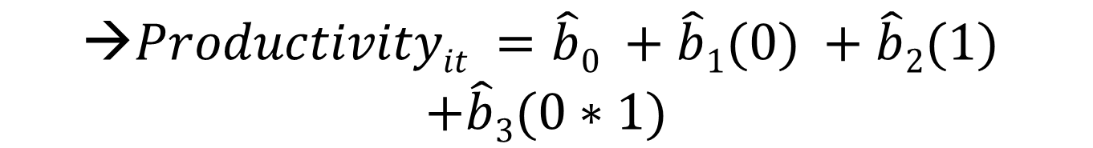
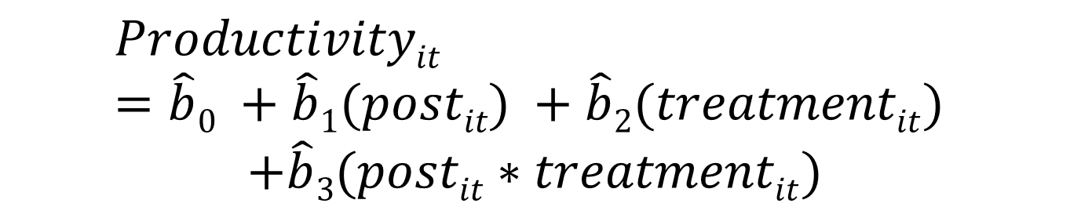
So what is the conditional mean in this case?
If Treatment = 1 and Post = 0, then our regression equation looks like this:
$$Productivityit =\hat{b}0 +\hat{b}1(postit) +\hat{b}2(treatmentit)$$
$$+\hat{b}3(postit∗treatmentit)$$
$$\text{→}Productivityit =\hat{b}0 +\hat{b}1(0) +\hat{b}2(1)$$
$$+\hat{b}3(0∗1)$$
$$\text{→}Productivityit =\hat{b}0 +\hat{b}2$$

Slide 44
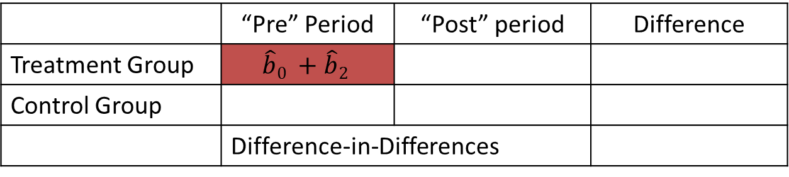
Quadrant #1: Treatment & “Pre”
So in this case:
 | “Pre” Period | “Post” period | Difference
Treatment Group | $$\hat{b}0 +\hat{b}2$$
Control Group
 | Difference-in-Differences

Slide 45
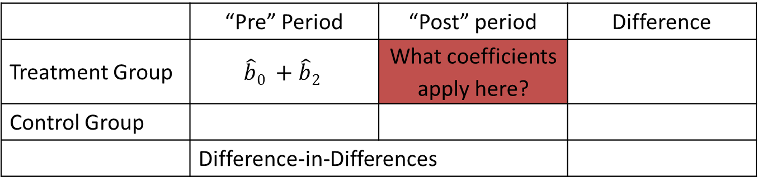
Quadrant #2: Treatment & “Post”
 | “Pre” Period | “Post” period | Difference
Treatment Group | $$\hat{b}0 +\hat{b}2$$ | What coefficients apply here?
Control Group
 | Difference-in-Differences
In this quadrant, what happens to the “treatment” dummy? And the “post” dummy?
Treatment = 1
Post = 1

Slide 46
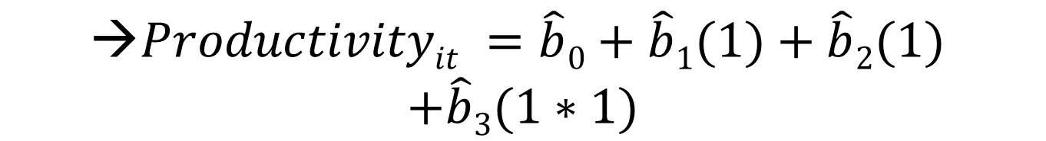
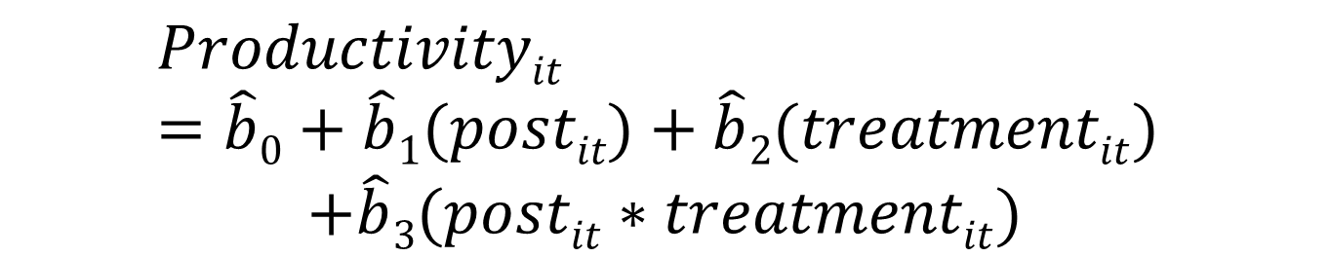
So what is the conditional mean in this case?
If Treatment = 1 and Post = 1, then our regression equation looks like this:
$$Productivityit =\hat{b}0+\hat{b}1(postit)+\hat{b}2(treatmentit)$$
$$+\hat{b}3(postit∗treatmentit)$$
$$\text{→}Productivityit =\hat{b}0+\hat{b}1(1)+\hat{b}2(1)$$
$$+\hat{b}3(1∗1)$$
$$\text{→}Productivityit =\hat{b}0 +\hat{b}1+\hat{b}2+\hat{b}3$$

Slide 47

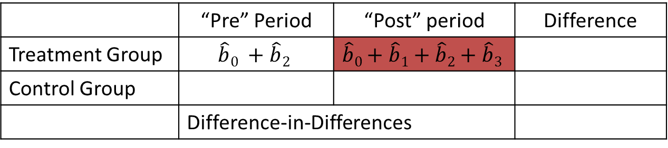
Quadrant #2: Treatment & “Post”
So in this case:
And we can go further here to the think about the “difference” between the post and pre periods for the treatment group.
 | “Pre” Period | “Post” period | Difference
Treatment Group | $$\hat{b}0 +\hat{b}2$$ | $$\hat{b}0+\hat{b}1+\hat{b}2+\hat{b}3$$
Control Group
 | Difference-in-Differences
$$\hat{b}1+\hat{b}3$$

Slide 48
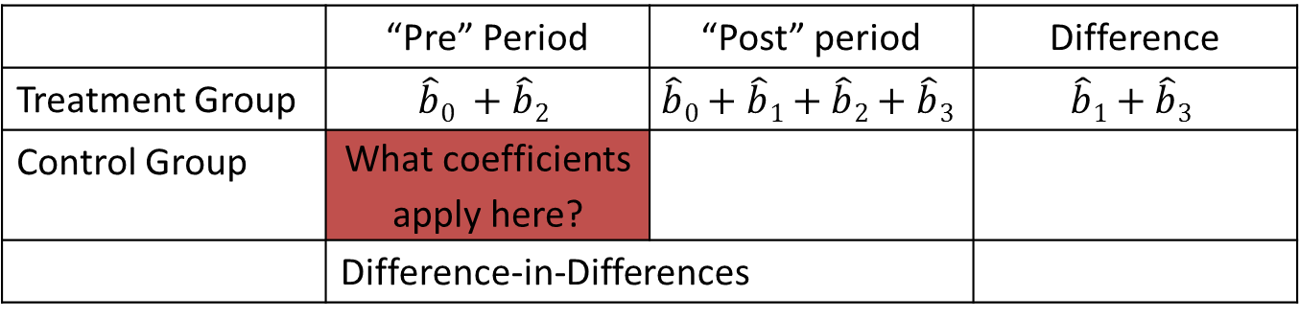
Quadrant #3: Control & “Pre”
 | “Pre” Period | “Post” period | Difference
Treatment Group | $$\hat{b}0 +\hat{b}2$$ | $$\hat{b}0+\hat{b}1+\hat{b}2+\hat{b}3$$ | $$\hat{b}1+\hat{b}3$$
Control Group | What coefficients apply here?
 | Difference-in-Differences
In this quadrant, what happens to the “treatment” dummy? And the “post” dummy?
Treatment = 0
Post = 0

Slide 49
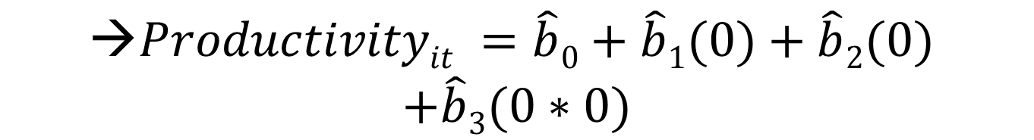
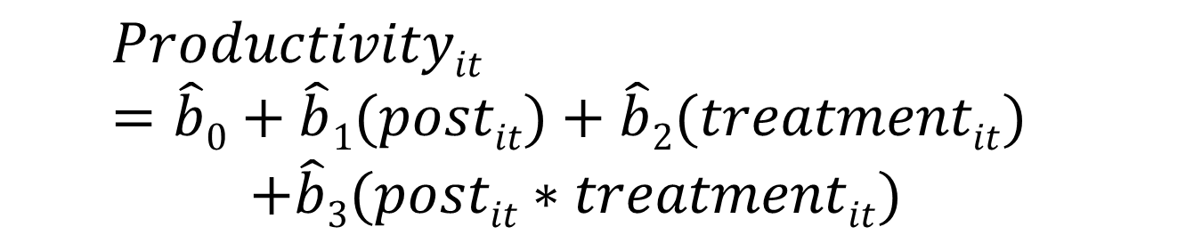
So what is the conditional mean in this case?
$$Productivityit =\hat{b}0+\hat{b}1(postit)+\hat{b}2(treatmentit)$$
$$+\hat{b}3(postit∗treatmentit)$$
$$\text{→}Productivityit =\hat{b}0+\hat{b}1(0)+\hat{b}2(0)$$
$$+\hat{b}3(0∗0)$$
$$\text{→}Productivityit =\hat{b}0$$

Slide 50
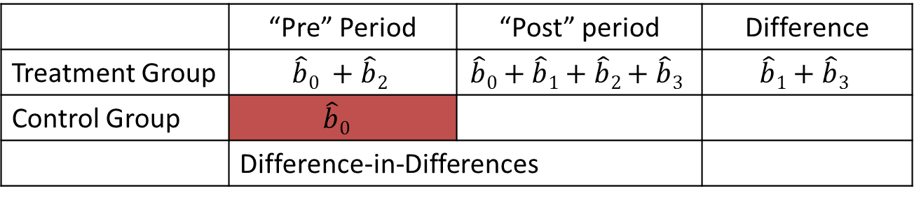
Quadrant #3: Control & “Pre”
So in this case
 | “Pre” Period | “Post” period | Difference
Treatment Group | $$\hat{b}0 +\hat{b}2$$ | $$\hat{b}0+\hat{b}1+\hat{b}2+\hat{b}3$$ | $$\hat{b}1+\hat{b}3$$
Control Group | $$\hat{b}0$$
 | Difference-in-Differences

Slide 51
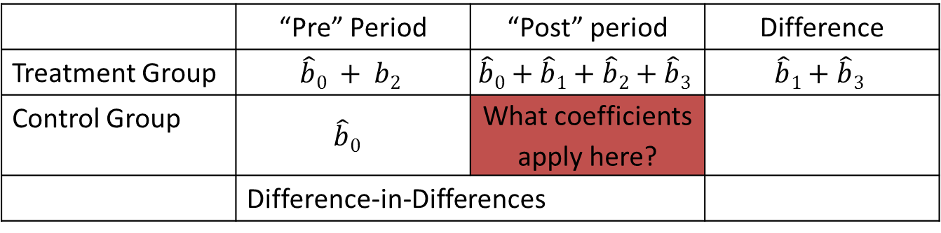
Quadrant #4: Control & Post
Last one:
 | “Pre” Period | “Post” period | Difference
Treatment Group | $$\hat{b}0 + b2$$ | $$\hat{b}0+\hat{b}1+\hat{b}2+\hat{b}3$$ | $$\hat{b}1+\hat{b}3$$
Control Group | $$\hat{b}0$$ | What coefficients apply here?
 | Difference-in-Differences
In this quadrant: (i) Treatment = 0 and
(ii) Post = 1

Slide 52
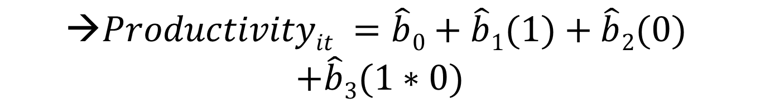

So what is the conditional mean in this case?
$$Productivityit =\hat{b}0+\hat{b}1(postit)+\hat{b}2(treatmentit)$$
$$+\hat{b}3(postit∗treatmentit)$$
$$\text{→}Productivityit =\hat{b}0+\hat{b}1(1)+\hat{b}2(0)$$
$$+\hat{b}3(1∗0)$$
$$\text{→}Productivityit =\hat{b}0+\hat{b}1$$

Slide 53

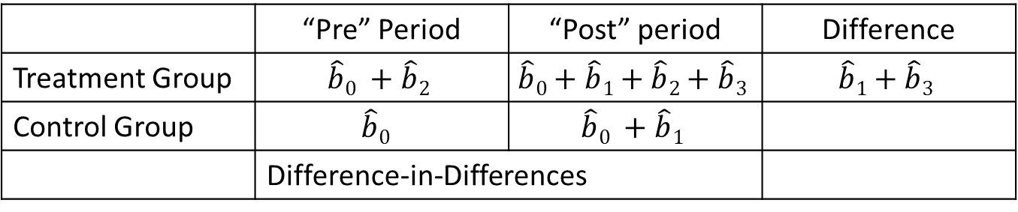

Put it all together
 | “Pre” Period | “Post” period | Difference
Treatment Group | $$\hat{b}0 +\hat{b}2$$ | $$\hat{b}0+\hat{b}1+\hat{b}2+\hat{b}3$$ | $$\hat{b}1+\hat{b}3$$
Control Group | $$\hat{b}0$$ | $$\hat{b}0 +\hat{b}1$$
 | Difference-in-Differences
$$\hat{b}1$$
$$\hat{b}3$$
So here’s the “difference” between the post and pre periods for the control group.
And now, the big payoff: the Difference-in-Differences!

Slide 54
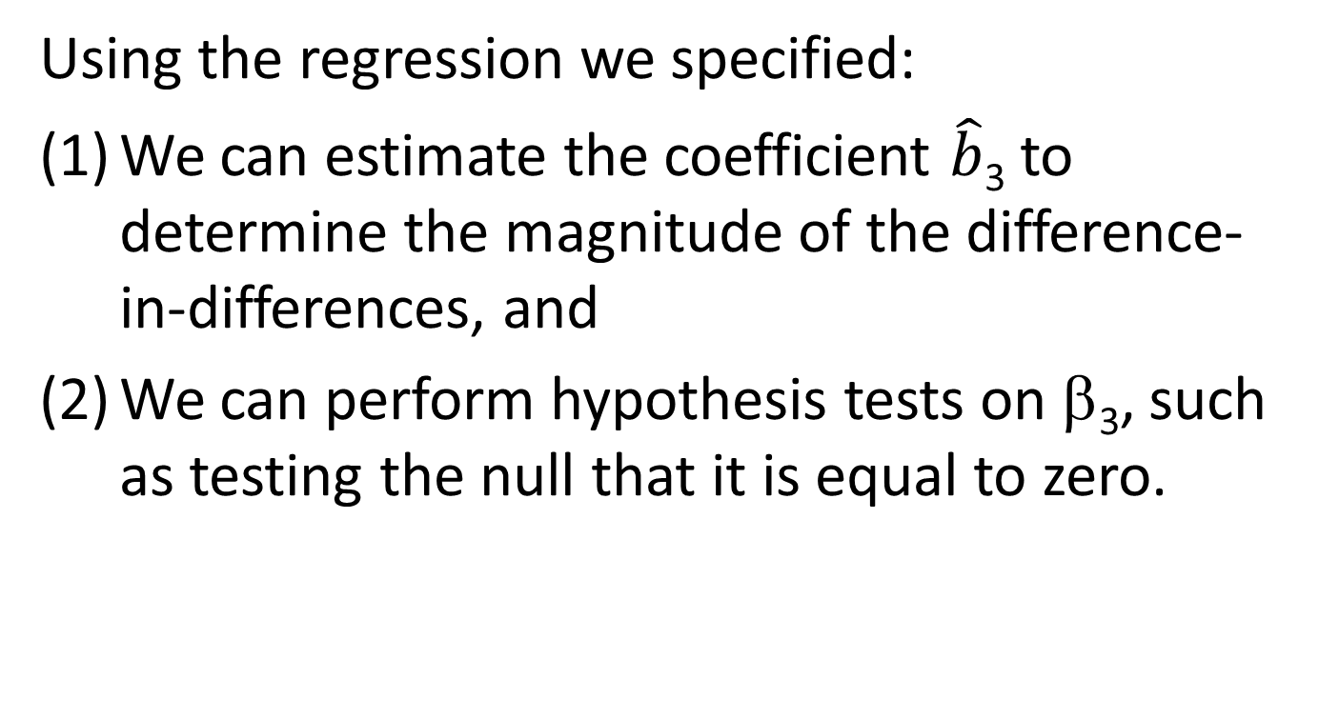
Big punch line
Using the regression we specified:
We can estimate the coefficient $\hat{b}$₃ to determine the magnitude of the difference-in-differences, and
We can perform hypothesis tests on β₃, such as testing the null that it is equal to zero.

Slide 55
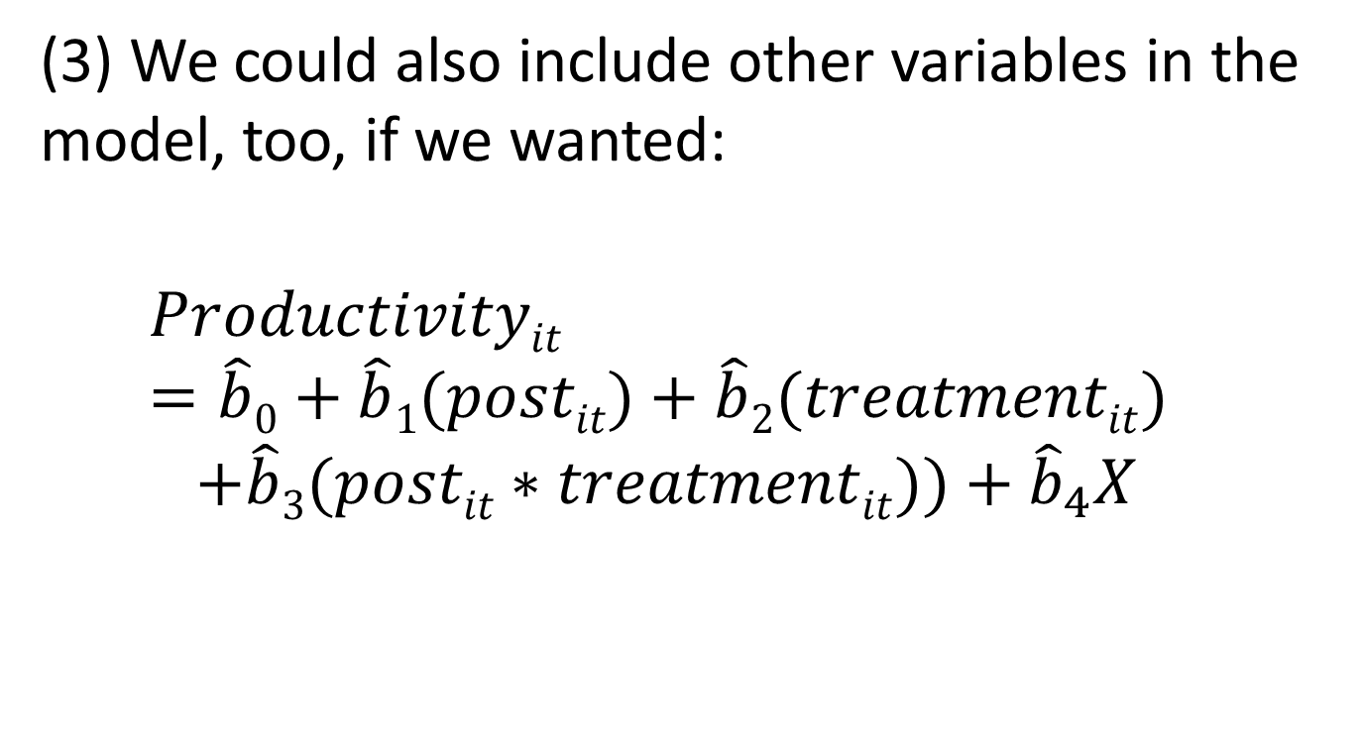
Big punch line
(3) We could also include other variables in the model, too, if we wanted:
$$Productivityit =\hat{b}0+\hat{b}1(postit)+\hat{b}2(treatmentit)$$
$$+\hat{b}3(postit∗treatmentit))+{\hat{b}}_{4}X$$

Slide 56
Back to the graphical intuition
We can now tie each of the four coefficients to the graph we used to think about the intuition here.

Slide 57







$\hat{b}$₀+$\hat{b}$₁+$\hat{b}$₂+$\hat{b}$₃
Treatment’s change = $\hat{b}$₁ + $\hat{b}$₃
$\hat{b}$₀ + $\hat{b}$₁
$\hat{b}$₀ + $\hat{b}$₂
Control’s change = $\hat{b}$₁
$\hat{b}$₀
“Pre” difference between
Control and Treatment = $\hat{b}$₂

Slide 58
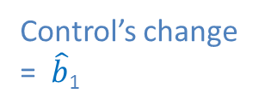
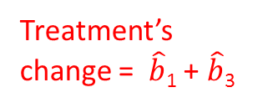

The D-i-D
D-i-D = $\hat{b}$₃
Treatment’s change = $\hat{b}$₁ + $\hat{b}$₃
Control’s change = $\hat{b}$₁

Slide 59
What does the graph show?
Essentially:
We assume that the control group shows us what would have happened to the treatment group if we never reorganized our firm.
By contrasting the change in the control group’s productivity with the change in the treatment group’s productivity, we measure the effect of interest.

Slide 60
Let’s go back to the cakes
Given what we’ve seen here, we can now ask the following question: how might we have looked at the causal impact of layers in our cake example even if we didn’t have data on frosting?
Let’s go step by step.

Slide 61
Let’s go back to the cakes
First, we’d formulate some treatment and control groups. Remember what our data look like:
Remember that an extra layer had NO impact on the price of the cake, after accounting for frosting.
 | One-Layer Cake | Two-Layer Cake
Two Cups of frosting | $16, $16 | $16, $16, $16, $16, $16, $16
One Cup of frosting | $10, $10, $10, $10, $10, $10 | $10, $10

Slide 62
Let’s go back to the cakes
Imaginary problem: How could arrive at a non-biased, causal effect for layers, even if we lacked information about the amount of frosting?
Remember: when we estimated the simple, bivariate regression here, we got the OVB answer (that was a problem)

Slide 63
Let’s go back to the cakes
Maybe a D-i-D approach could help us…
We’ve got 8 one-layer cakes in our data, so suppose that we randomly split up this group of one-layer cakes into two groups: a group of 4 “control” cakes, and a group of 4 “treatment” cakes.

Slide 64
Let’s go back to the cakes
If we did things correctly, we’d end up with two identical groups: each would have one cake with two cups of frosting, and three with one cup of frosting.

Slide 65
Let’s go back to the cakes
Treatment | Control
2 cups | $16, | $16
1 cup | $10, $10, $10, | $10, $10, $10
Pre average: $11.5 | $11.5

Slide 66
Let’s go back to the cakes
So in our “pre” period, the average price of the treatment and control groups are the same.
Now, suppose on the following day (which we’ll call the “post” period), we did the same randomization with our eight cakes, but instructed our bakers to put an extra layer on the four “treatment” cakes.

Slide 67
Let’s go back to the cakes
How much would customers pay for the treatment and control cakes in this post period?
Well, we know what the control group will look like

Slide 68
Let’s go back to the cakes
Treatment | Control
2 cups |  | $16
1 cup |  | $10, $10, $10
Post Average |  | $11.5

Slide 69
Let’s go back to the cakes
What about the Treatment cakes?
Recall the table:
So what happens when we add a layer to a cake with one cup of frosting?
 | One-Layer Cake | Two-Layer Cake
Two Cups of frosting | $16, $16 | $16, $16, $16, $16, $16, $16
One Cup of frosting | $10, $10, $10, $10, $10, $10 | $10, $10
One-Layer Price = $10
→ Two-Layer Price = $10

Slide 70
Let’s go back to the cakes
And what happens when we add a layer to a cake with two cups of frosting?
So what does our Treatment sample look like in this Post period?
One-Layer Price = $16
→ Two-Layer Price = $16

Slide 71
Let’s go back to the cakes
Treatment | Control
2 cups | $16, | $16
1 cup | $10, $10, $10, | $10, $10, $10
Post average: $11.5 | $11.5

Slide 72
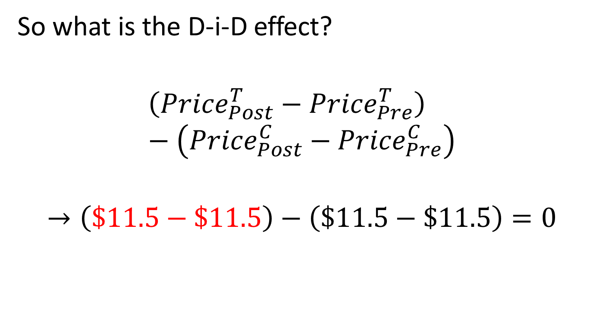
Let’s go back to the cakes
So what is the D-i-D effect?
$$\left({Price}_{Post}^{T}−{Price}_{Pre}^{T}\right)−\left({Price}_{Post}^{C}−{Price}_{Pre}^{C}\right)$$
$$→\left(\$11.5−\$11.5\right)−\left(\$11.5−\$11.5\right)=0$$

Slide 73
Let’s go back to the cakes
Key point:
Even without information about frosting, a randomized D-i-D approach circumvents the OVB problem and gives us an unbiased, causal effect.
This is the key payoff for us!

Slide 74

Regressions and D-i-D
So we can estimate the Difference-in-Differences with the coefficient $\hat{b}$₃!
Let’s try this out
Open up “EMBADID.xls”

Slide 75
Regressions and D-i-D
The data include a few relevant variables:
Year
ID (a number for each person in our data – you’ll note we have two observations for each person)
Three dummy variables: “Treatment”, “Post”, and their interaction “Posttreat”
Each individual’s productivity

Slide 76
Regressions and D-i-D
Make a 2x2 table that compares the average productivity for the treatment and control groups in the pre-treatment period (2010) and the post-treatment period (2011)
Manually calculate the Difference-in-Differences with this table
Run a regression to perform the same calculation.

Slide 77
My results
First, the table:
 | “Pre” (2010) | “Post” (2011) | Difference
Treatment | $19.95 | $30.05 | $10.10
Control | $20.38 | $21.71 | $1.33
 | Difference-in-Differences |  | $8.77

Slide 78
What do we see?
Note: This is another example of a “good” difference-in-differences.
In the “pre” period, the treatment and control groups look awfully similar.
But how do the regression results look?

Slide 79
Regression results
R Square | 0.672855
Standard Error | 2.915843
Observations | 500
 | df | SS | MS
Regression | 3 | 8673.416 | 2891.139
Residual | 496 | 4217.061 | 8.502139
Total | 499 | 12890.48
 | Coefficients | Standard Error | t Stat
Intercept | 20.38456 | 0.260801 | 78.16138
Post | 1.33024 | 0.368828 | 3.606666
Treatment | -0.43912 | 0.368828 | -1.19058
Posttreat | 8.7708 | 0.521602 | 16.81513

Slide 80
What are the main issues?
All of the coefficients take on meaning -- what are these meanings? And why are these meanings somewhat familiar to us, given our earlier table?
What are the test statistics for each of the coefficients? And what does their statistical significance (or lack thereof) imply?

Slide 81
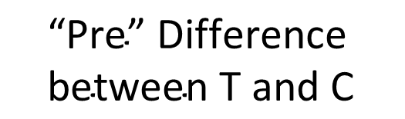

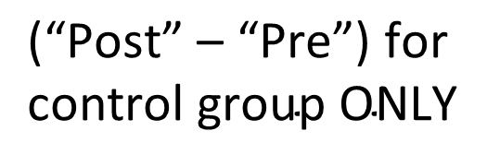




The Coefficients
Coefficient | T-statistic | Meaning
b₀
b₁
b₂
b₃
$$\frac{b_{0}−β_{0}}{se(b_{0})}=\text{78.2}$$
$$\text{“}\text{Pre}\text{” }\text{average} \text{for} \text{control} \text{group}$$
$$\frac{b_{1}−β_{1}}{se\left(b_{1}\right)}=\text{3.6}$$
$$\text{(“}\text{Post}\text{” – “}\text{Pre}\text{”) }\text{for} \text{control} \text{group} \text{ONLY}$$
$$\frac{b_{2}−β_{2}}{se\left(b_{2}\right)}=−1.2$$
$$\text{“}\text{Pre}\text{” }\text{Difference} \text{between} \text{T} \text{and} \text{C}$$
$$\frac{b_{3}−β_{3}}{se\left(b_{3}\right)}=16.8$$
D-i-D!

Slide 82
Switching gears: Pitfalls
Diff-in-diff is a great tool, but we need to be mindful of how it can tell us different stories, and some potential problems with it.
Basically, we need to be aware of instances when we have data that don’t look like the example we just analyzed.

Slide 83
A Problematic D-i-D
Suppose instead that we had something like this:
 | Pre-treatment average productivity | Post-treatment average productivity | Difference
Treatment Group | $30 | $38 | +$8
Control Group | $11 | $13 | +$2
 | Difference-in-Differences |  | $8 – ($2) = +$6

Slide 84
A Problematic D-i-D
Problem: pre-treatment differences between the groups
What might that imply?
Is there a fix?

Slide 85
A D-i-D that tells a different story
Now suppose instead that we have something like this:
 | Pre-treatment average productivity | Post-treatment average productivity | Difference
Treatment Group | $12 | $20 | +$8
Control Group | $11 | $18 | +$7
 | Difference-in-Differences |  | $8 – ($7) = +$1

Slide 86
A D-i-D that tells a different story
Treatment group has a benefit, but control shows that they would have improved anyway.
What does this tell us?

Slide 87
Some other warning signs
Hawthorne effects?
Contamination of Control group by the Treatment group?
Event simultaneous with intervention that only impacts one group (Treatment OR Control group) but NOT the other
Were the two groups trending in the same direction well in advance of the intervention?

Slide 88
(1) Hawthorne Effects
The treatment group (and/or the control group) alters its behavior because it is being observed.
The causal effect is thus not due to treatment, but observation (which is not what we want to know)

Slide 89
(2) Contamination of the Control Group
Does receipt of treatment impart an effect on the control group, too?
Training: T teaches C the techniques
Coupon: C gets irritated by lack of benefit imparted to T

Slide 90
The D-i-D table – with a twist!
 | “Pre” Period | “Post” period | Difference
Treatment Group | A | B | B – A
Control Group | C | D | D – C
 | Difference-in-Differences |  | (B – A) – (D – C) = DID*
Note, for future reference, we’ll use the term DID* to denote the amount (B – A) – (D – C). This is the “true” D-i-D value we’d get if there were no problems with our framework. So with this in hand, let’s re-examine the problem here

Slide 91
The D-i-D table – with a twist!
Let’s use the term “X” to represent the effect of the treatment group’s contamination of the control group
 | “Pre” Period | “Post” period | Difference
Treatment Group | A | B | B – A
Control Group | C
 | Difference-in-Differences
(D + X) – C
= (D – C) + X
D + X
(B – A) – [(D – C) + X]
= [(B – A) – (D – C)] – X
= [DID*] – X
So this type of contamination causes our estimate to be downward-biased.

Slide 92
(3) Simultaneous, Separate contamination of one group
The control group is supposed to tell us what would have happened to the treatment group but for a single event.
To show what happens when TWO events occur together, suppose that a negative economic shock hits C, but not T. And this shock happens at the same time as treatment.
Let’s call this shock Y

Slide 93
Back to the D-i-D table!
 | “Pre” Period | “Post” period | Difference
Treatment Group | A | B | B – A
Control Group | C
 | Difference-in-Differences
(D – Y) – C
= (D – C) – Y
D – Y
(B – A) – [(D – C) – Y]
= [(B – A) – (D – C)] + Y
= [DID*] + Y
So this type of problem causes our estimate to be upward-biased.

Slide 94
(3A) Simultaneous, Separate contamination of both groups
As a related point, suppose that BOTH the treatment and control groups experienced an identical, negative economic shock that was simultaneous treatment.
Again, let’s call this shock Z

Slide 95
Back to the D-i-D table!
 | “Pre” Period | “Post” period | Difference
Treatment Group | A
Control Group | C
 | Difference-in-Differences
(B – Z) – A
= (B – A) – Z
B – Z
(D – Z) – C
= (D – C) – Z
D – Z
[(B – A) – Z] – [(D – C) – Z]
= [(B – A) – (D – C)] – Z + Z
= [DID*] – Z + Z
= [DID*]
So this type of issue is actually not a problem – it just cancels out

Slide 96
(4) Trends
This picture looks pretty good: (T and C)
●
●
●
●

Slide 97
(4) Trends
But not now…
●
●
●
●
●
●
●
●
●
●
●
●
●
●
●
●

